Slide 1
Transfer Learning
Reconocimiento de Patrones
Julio Waissman

Slide 2
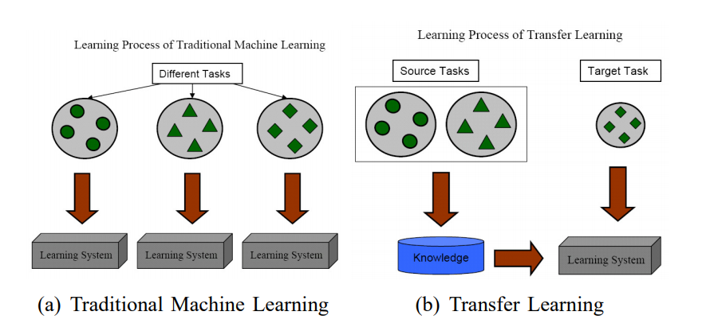
Idea básica de transfer learning

Slide 3
Tipos de transfer learning
Inductivo
Adaptar modelo existente a nuevos datos etiquetados
Transductivo
Adaptar modelo existente a nuevos datos no etiquetados
No supervisado
Adaptar modelo no supervisado existente a nuevos datos no etiquetados

Slide 4
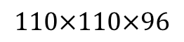
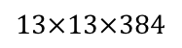
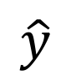
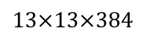

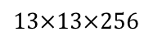

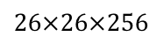
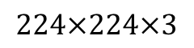
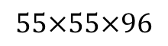
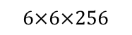
¿Qué aprende una CNN?
Note: 3 by 3 max pool with stride 2:
$$\hat{y}$$
$$⋮$$
$$⋮$$
$$26×26×256$$
$$13×13×256$$
$$13×13×384$$
$$13×13×384$$
$$6×6×256$$
$$55×55×96$$
FC
4096
FC
4096
$$224×224×3$$
$$110×110×96$$
Tomamos 9 unidades por capa al azar
Buscamos los 9 parches de muchas imágenes (en la imagen original) que maximice la activación
[Zeiler and Fergus., 2013, Visualizing and understanding convolutional networks]

Slide 5
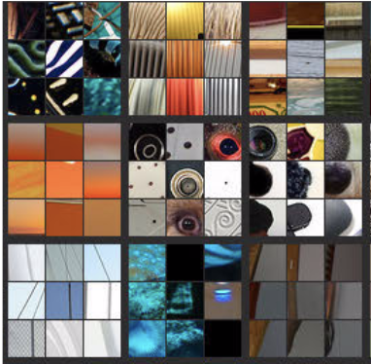
Visualizing deep layers
Layer 1
Layer 2
Layer 3
Layer 4
Layer 5

Slide 6
Visualizing deep layers: Layer 1
Layer 1
Layer 2
Layer 3
Layer 4
Layer 5

Slide 7
Visualizing deep layers: Layer 2
Layer 1
Layer 2
Layer 3
Layer 4
Layer 5

Slide 8
Visualizing deep layers: Layer 3
Layer 1
Layer 2
Layer 3
Layer 4
Layer 5

Slide 9
Visualizing deep layers: Layer 3
Layer 1
Layer 2
Layer 3
Layer 4
Layer 5

Slide 10
Visualizing deep layers: Layer 4
Layer 1
Layer 2
Layer 3
Layer 4
Layer 5

Slide 11
Visualizing deep layers: Layer 5
Layer 1
Layer 2
Layer 3
Layer 4
Layer 5

Slide 12
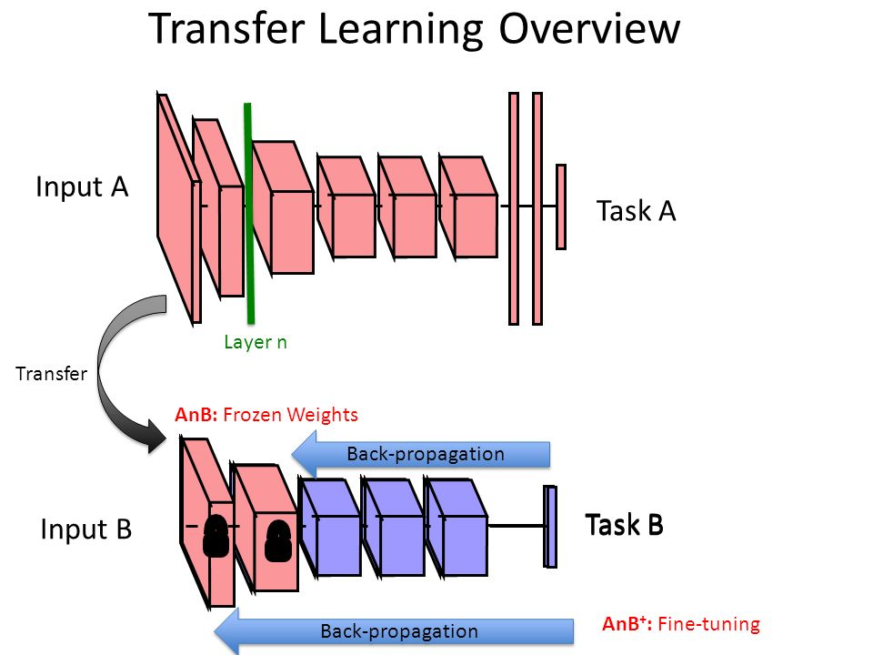

Slide 13
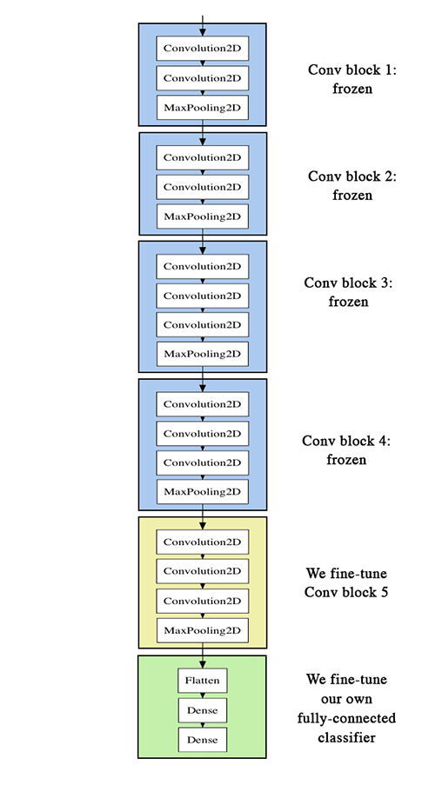
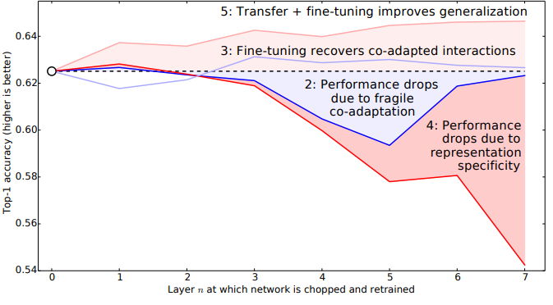
¿Cómo hacer el transfer learning?

Slide 14

Algunos modelos conocidos: VGG-16

Slide 15
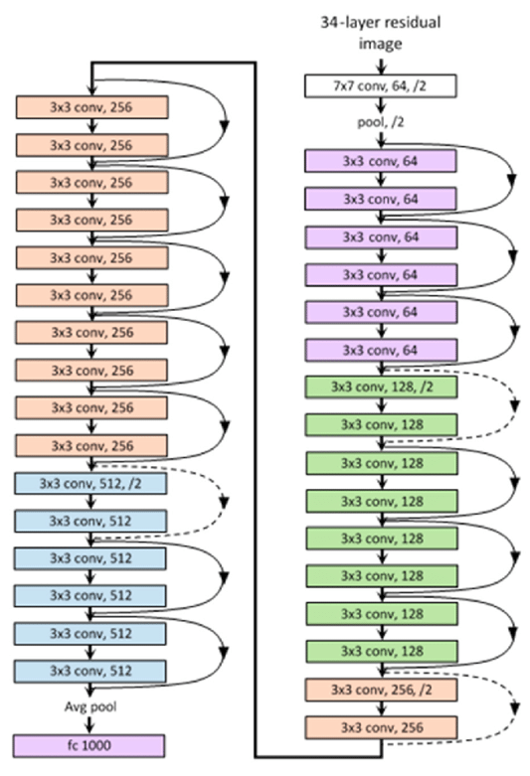
Algunos modelos conocidos: ResNet

Slide 16
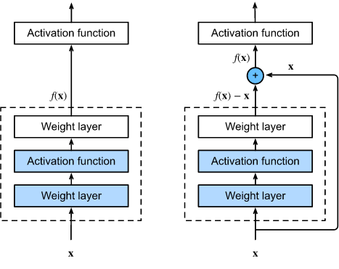
Algunos Modelos: ResNet

Slide 17
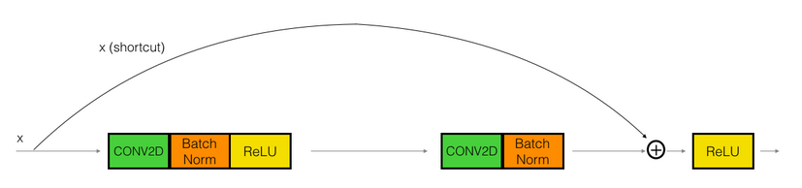
Algunos Modelos: ResNet

Slide 18
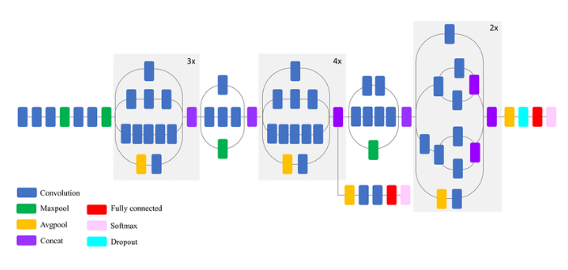
Algunos modelos: Inception

Slide 19
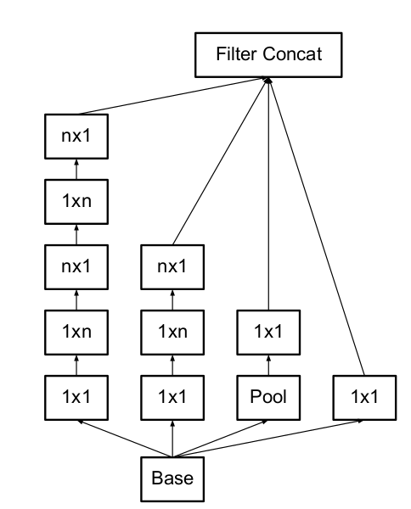
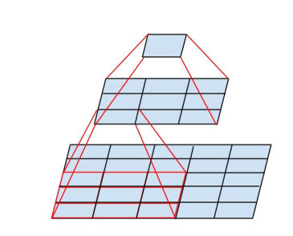
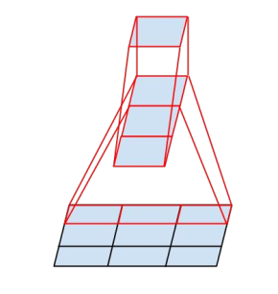
Algunos modelos: Inception

Slide 20
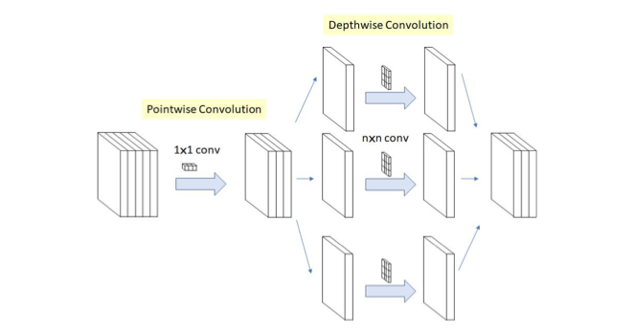
Algunos modelos: Xception

Slide 21
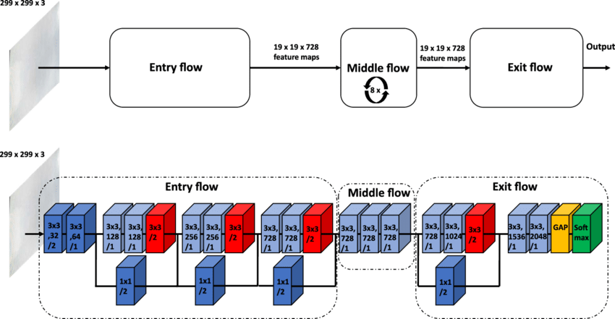
Algunos modelos: Xception

Slide 22
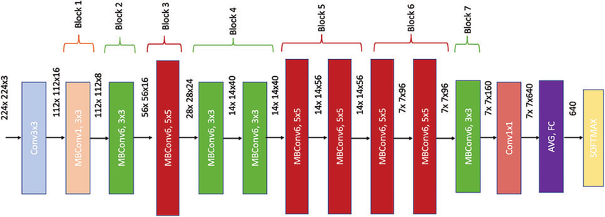
Algunos modelos: EfficientNet

Slide 23
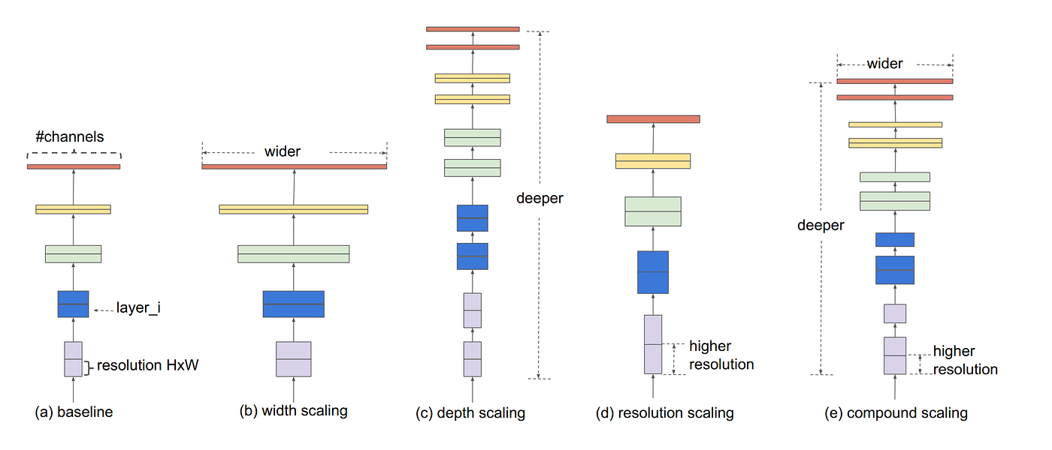
Algunos modelos: EfficientNet

Slide 24
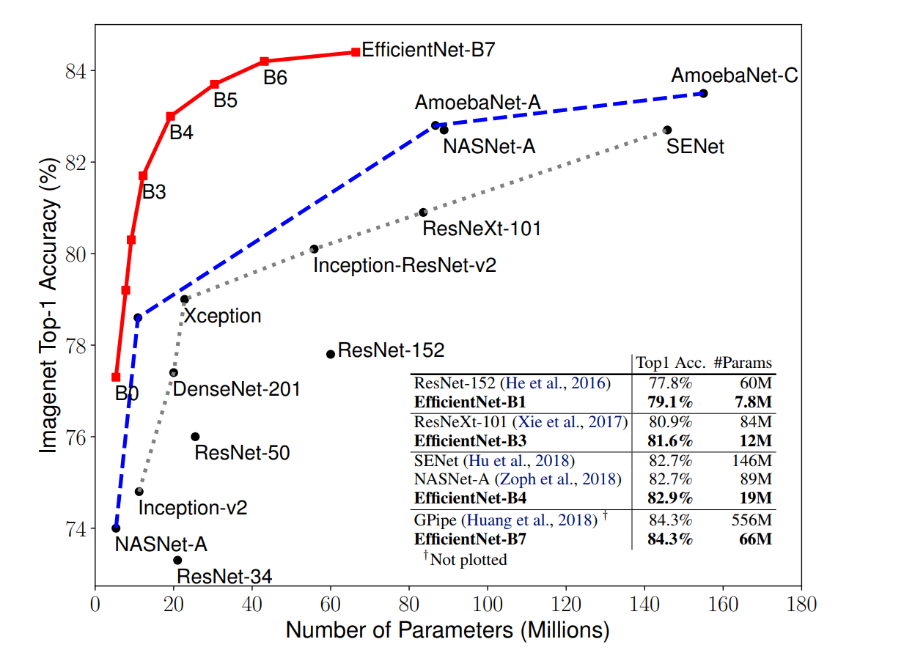
Algunos modelos: EfficientNet

Slide 25
¿Dónde consultar modelos existentes?
Model Zoo: https://modelzoo.co
Hugging face: https://huggingface.co/models
Awesome computer visión models: https://github.com/gmalivenko/awesome-computer-vision-models

Slide 26

Neural Style Transfer
deeplearning.ai

Slide 27
Neural style transfer
Content
Style
Content
Style
Generated image
Generated image
[Images generated by Justin Johnson]

Slide 28
Neural style transfer cost function
Content C
Style S
Generated image G
[Gatys et al., 2015. A neural algorithm of artistic style. Images on slide generated by Justin Johnson]

Slide 29

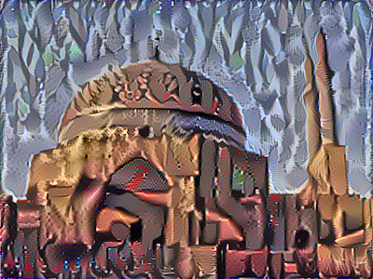
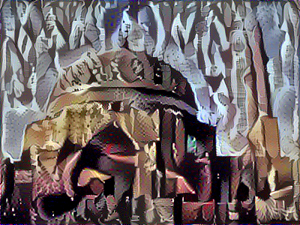
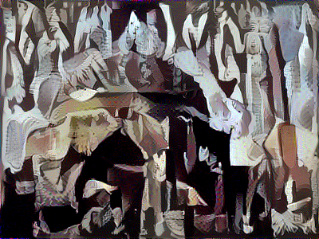
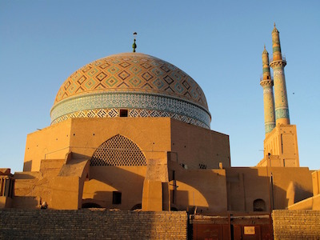
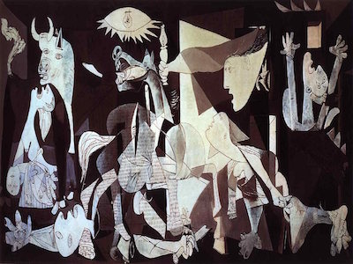
Find the generated image G
1. Initiate G randomly
G: $100×100×3$
2. Use gradient descent to minimize $J(G)$
[Gatys et al., 2015. A neural algorithm of artistic style]

Slide 30
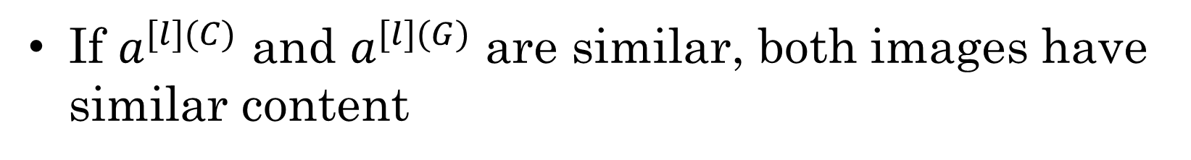
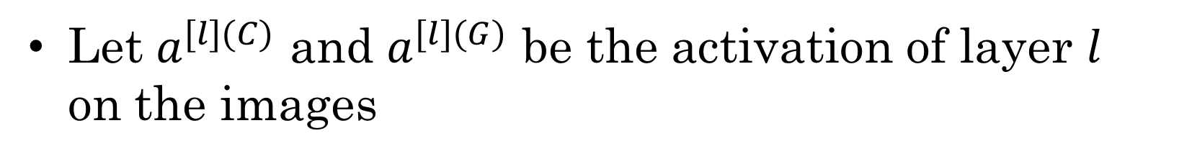
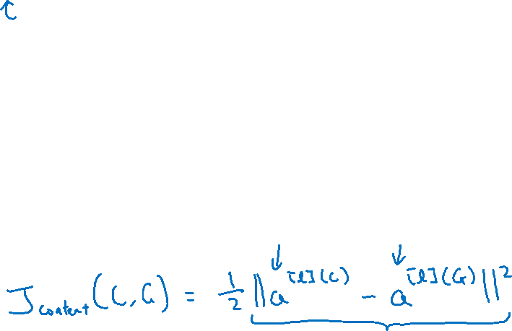
Content cost function
$$J\left(G\right)=α J_{content}\left(C,G\right)+β J_{style }(S,G)$$
Say you use hidden layer $l$ to compute content cost.
Use pre-trained ConvNet. (E.g., VGG network)
Let $a^{[l](C)}$ and $a^{[l](G)}$ be the activation of layer $l$ on the images
If $a^{[l](C)}$ and $a^{[l](G)}$ are similar, both images have similar content
[Gatys et al., 2015. A neural algorithm of artistic style]

Slide 31
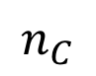
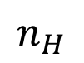
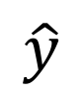
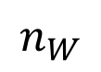
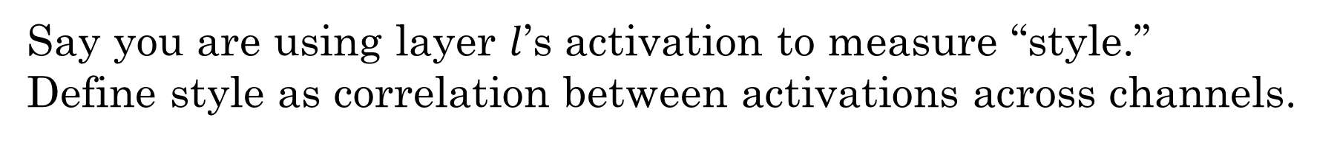
Meaning of the “style” of an image
$$\hat{y}$$
$$⋮$$
Say you are using layer $l$’s activation to measure “style.”
Define style as correlation between activations across channels.
How correlated are the activations across different channels?
$$n_{H}$$
$$n_{C}$$
$$n_{W}$$
[Gatys et al., 2015. A neural algorithm of artistic style]

Slide 32
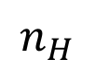
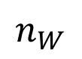
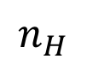
Intuition about style of an image
Style image
Generated Image
$$n_{H}$$
$$n_{H}$$
$$n_{C}$$
$$n_{C}$$
$$n_{W}$$
$$n_{W}$$
[Gatys et al., 2015. A neural algorithm of artistic style]

Slide 33
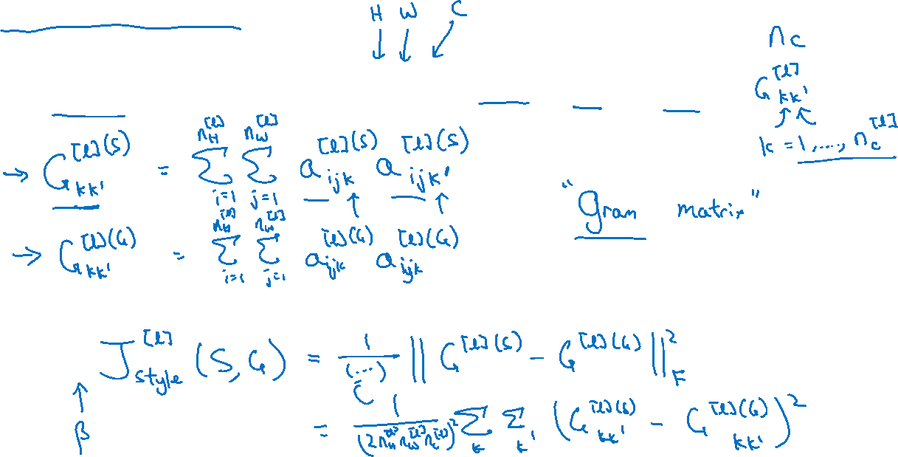
Style matrix
Let $a_{i,j,k}^{[l]}=$ activation at $\left(i,j,k\right). G^{[l]}$ is $n_{c}^{[l]}×n_{c}^{[l]}$
[Gatys et al., 2015. A neural algorithm of artistic style]

Slide 34
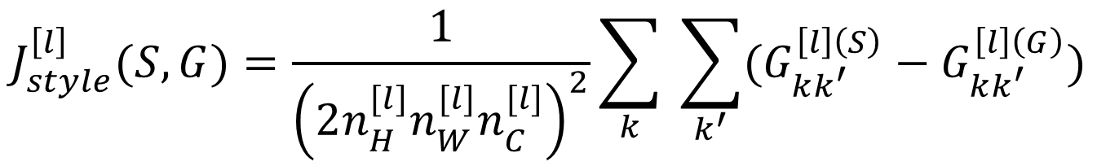
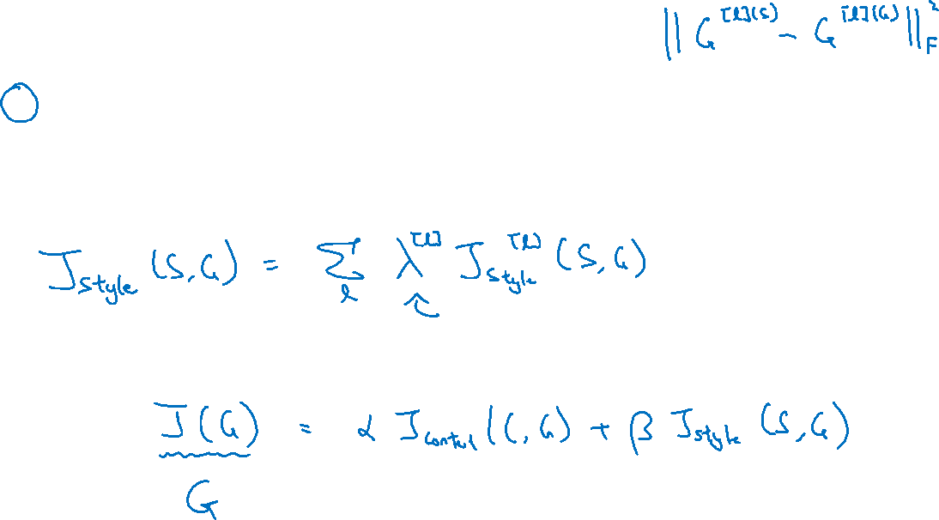
Style cost function
$$J_{style}^{\left[l\right]}(S,G)=\frac{1}{{\left(2n_{H}^{[l]}n_{W}^{[l]}n_{C}^{[l]}\right)}^{2}}\sum_{k}{ \sum_{k^{′}}{(G_{kk^{′}}^{\left[l\right]\left(S\right)}−G_{kk^{′}}^{\left[l\right]\left(G\right)})}}$$
[Gatys et al., 2015. A neural algorithm of artistic style]

Slide 35
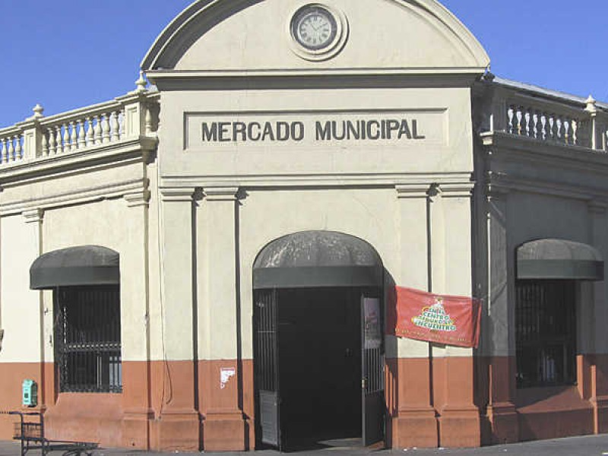
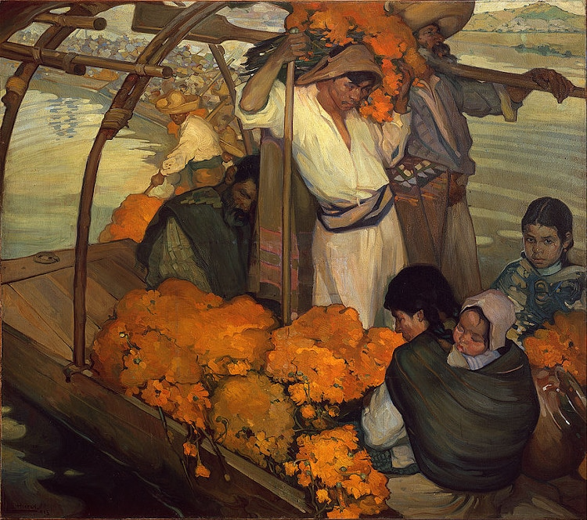
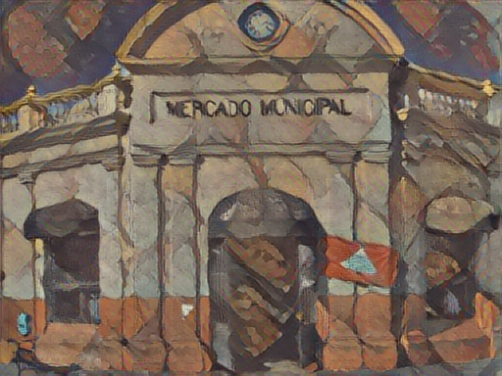
Ejemplos
Jose Luís Aguilera Luzanía

Slide 36
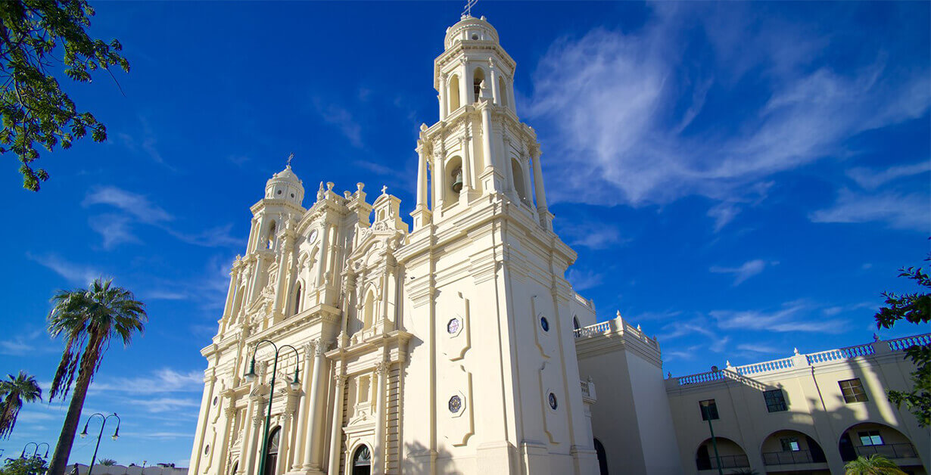
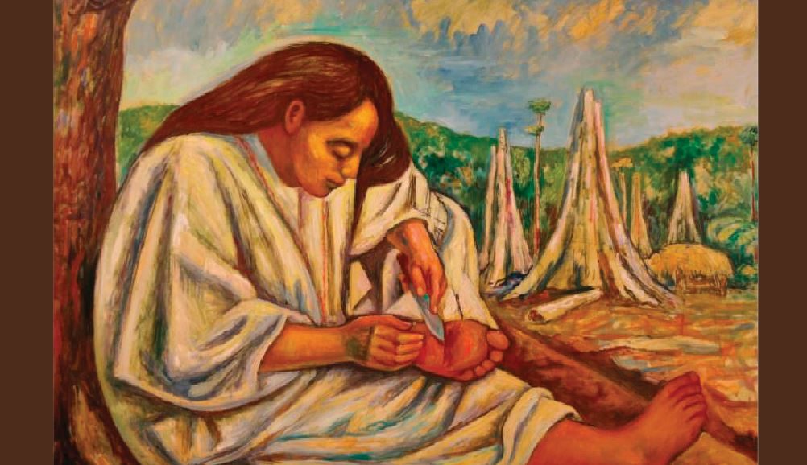

Ejemplos
Christopher Arce Díaz

Slide 37



Ejemplos
Raúl Murcia Yocupicio

Slide 38



Ejemplos
Ximena Sandoval

